Slide 1
Personalized Schedules for Invasive Diagnostic Tests
With Applications in Surveillance of Chronic Non-Communicable Diseases

Slide 2
Low-grade
Progressed

Slide 3
Low-grade
Progressed

Slide 4
Disease State
Physical Exam
Medical Imaging (e.g., MRI)
Biomarker
(urine or blood test)
Invasive Test

Slide 5
Disease State
Physical Exam
Medical Imaging (e.g., MRI)
Biomarker
(urine or blood test)
Invasive Test

Slide 6
Disease State
Physical Exam
Medical Imaging (e.g., MRI)
Biomarker
(urine or blood test)
Invasive Test

Slide 7
Disease State
Physical Exam
Invasive Test
Medical Imaging (e.g., MRI)
Biomarker
(urine or blood test)

Slide 8
Biomarkers / Physical Exam
Less burdensome
More frequent
Less conclusive
Invasive Test
More burdensome
Less frequent
More conclusive

Slide 11
Previous Test Results
Biomarker
MRI
Benefit
Burden
Schedule Burden vs. Benefit
Disease State
Personalized Schedule

Slide 12
Previous Test Results
Biomarker
MRI
Benefit
Burden
Schedule Burden vs. Benefit
Disease State
Personalized Schedule

Slide 13
Previous Test Results
Biomarker
MRI
Benefit
Burden
Schedule Burden vs. Benefit
Disease State
Personalized Schedule

Slide 14
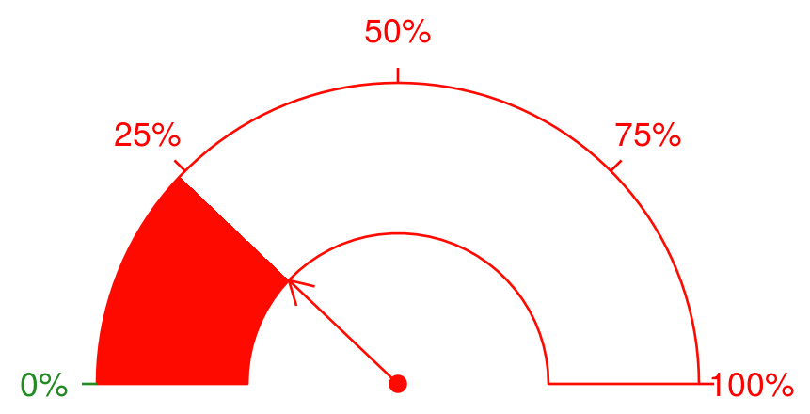
Random Effects
(State)
Model 1 Physical Exam
Relative Risk Model Previous Invasive Test Results
Model 3 MRI
Model 2 Blood Biomarker
Risk of Progression: 23%

Slide 15
Random Effects
(State)
Model 1 Physical Exam
Relative Risk Model Previous Invasive Test Results
Model 3 MRI
Model 2 Blood Biomarker
Risk of Progression: 23%

Slide 16
Random Effects
(State)
Model 1 Physical Exam
Model 4 Previous Invasive Test Results
Model 3 MRI
Model 2 Blood Biomarker
Risk of Progression: 23%

